Slide 1
WORLD CLASS DIGITAL X-RAY SYSTEMS

Slide 2
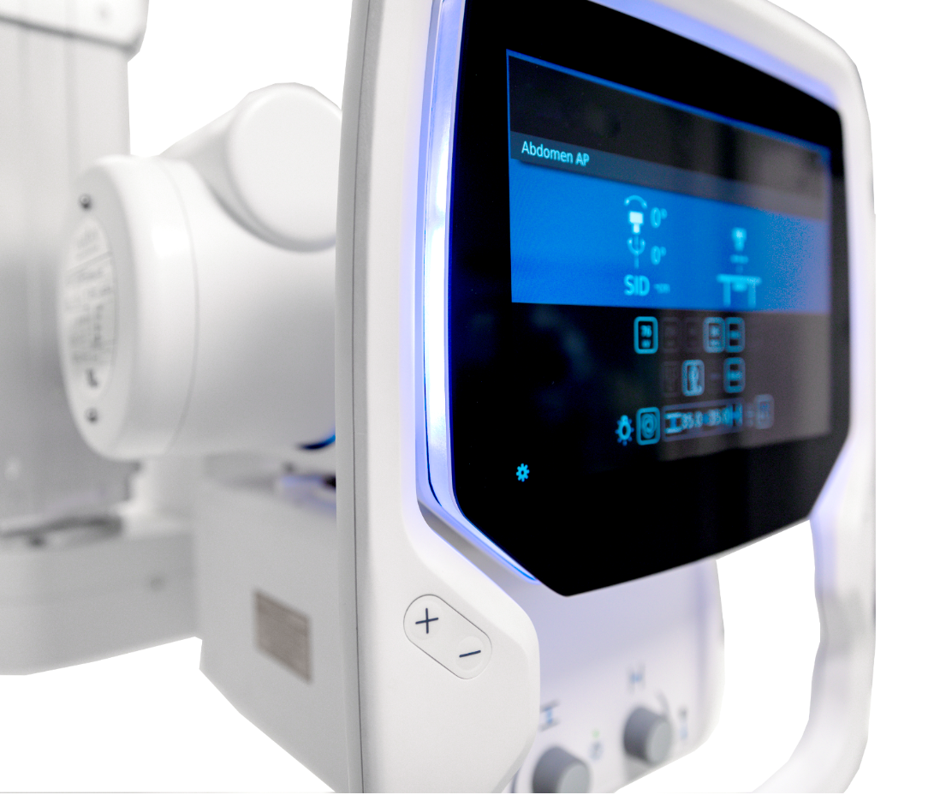
ABOUT US
Arcoma develops, produces and provides complete radiology solutions worldwide with the mission to improve care for the patient and work environment for the user.
Reduce healthcare costs
Improve work environment
Improve patient care

Slide 3
3500 SYSTEMS
INSTALLED GLOBALLY
More than 30 years of experience
Trusted partner with global reach
Swedish development and manufacturing
Listed at NASDAQ OMX First north, Sweden

Slide 4
OUR MARKET COVERAGE
Sales channels:
Partners
OEM

Slide 5
Arcoma offer product solutions covering key clinical applications in the radiology area.
GENERAL CLINIC
MUSCLE/ SCELETON CLINIC
THORACIC CLINIC
PEDIATRIC CLINIC
TRAUMA/
RESUS CLINIC
Notes:
https://www.istockphoto.com/se/foto/patienten-gubbe-h%C3%A5ller-hj%C3%A4rta-f%C3%B6r-hj%C3%A4rtinfarkt-koncept-gm1049772140-280738636
https://www.istockphoto.com/se/foto/sjukgymnaster-anv%C3%A4nder-h%C3%A4nderna-f%C3%B6r-att-greppa-patientens-l%C3%A5r-f%C3%B6r-att-kontrol-lera-gm1147201070-309365276
https://www.istockphoto.com/se/foto/l%C3%A4kare-att-unders%C3%B6ka-patientens-medicinska-journaler-gm902231646-248883193

Slide 6
SUPERIOR WORKFLOW
OUR PRODUCTS ENABLE
HIGH EFFICIENCY AND RELIABILITY
EXCELLENT DIAGNOSTIC RESULT
Notes:
https://www.istockphoto.com/se/foto/osk%C3%A4rpa-bildbakgrund-av-korridor-i-sjukhus-eller-klinik-bild-gm974363768-265081917

Slide 7
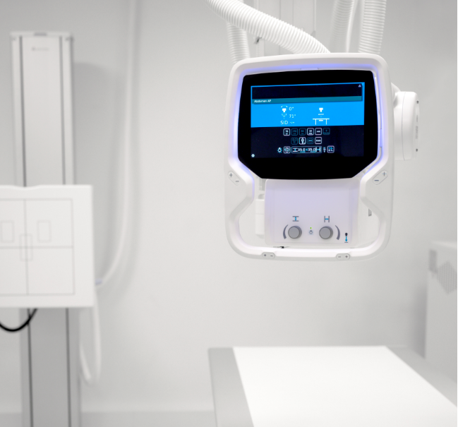
OUR PRODUCT LINES
ARCOMA PRECISION i5
PREMIUM DIGITAL X-RAY SYSTEM
The Arcoma Precision i5 is premium X-ray system developed with focus on efficient workflow, safety and ease of use. The ergonomic design simplifies and optimizes positioning and has been carefully designed to facilitate disinfection.
Arcoma Precision i5 is equipped with the latest touch screen technology and a user interface which creates simplicity and efficiency. A wall stand with motorized tilt simplifies positioning and the X-ray table improves patient and user experience.
Non-stop operation
Quick installation
Easy positioning in all directions
Notes:
To change the image behind the Mock up.
Select the layer - > Right Click -> Send to Back -> Delete the image -> Drag & Drop your Own Picture -> Send to Back (again)

Slide 8
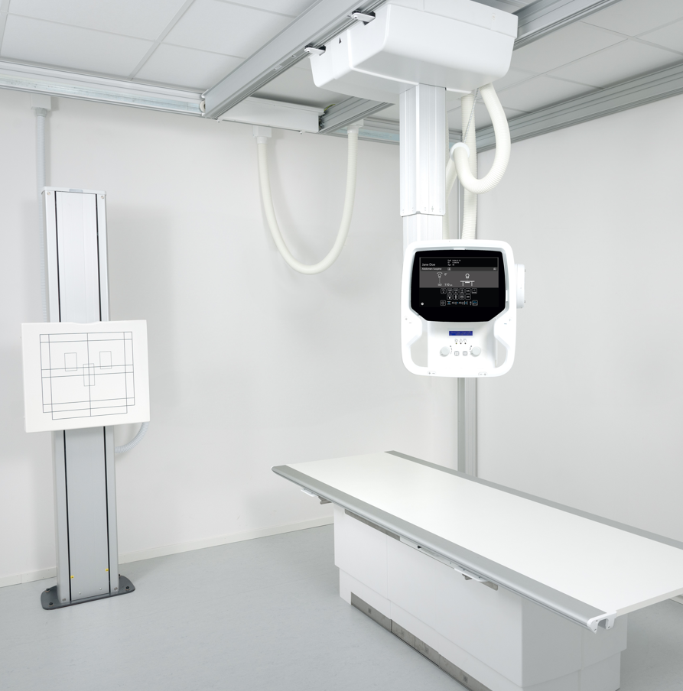
OUR PRODUCT LINES
ARCOMA INTUITION i3
VERSATILE DIGITAL RADIOGRAPHY SYSTEM
Arcoma Intuition i3 is a versatile digital radiography system that combines outstanding image quality with clinical flexibility and high productivity for a wide range of radiographic applications. The cost-effective, modular concept allows you to configure the system to precisely fit your room and your clinical requirements.
Light-weight
Easy positioning
Superior installation flexibility
Notes:
To change the image behind the Mock up.
Select the layer - > Right Click -> Send to Back -> Delete the image -> Drag & Drop your Own Picture -> Send to Back (again)

Slide 9
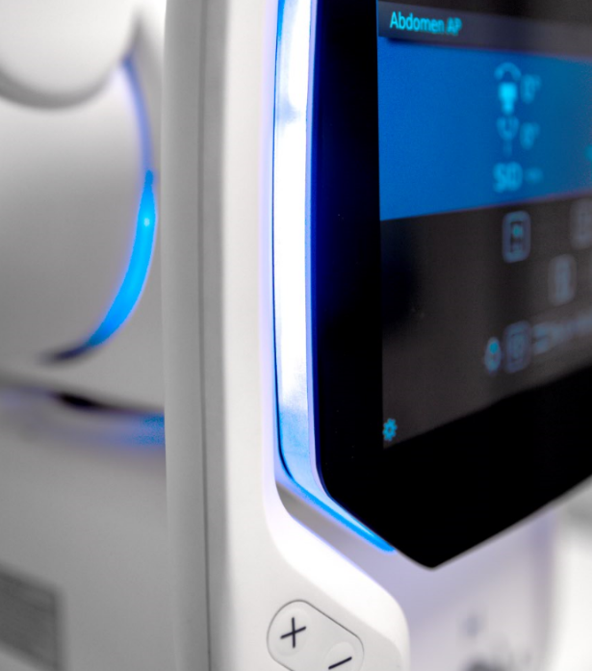
QUALITY IS OUR HIGHEST PRIORITY
CE MARKED ACCORDING TO MDR
INHOUSE TESTING
INHOUSE PRODUCTION
CERTIFIED ACCORDING TO ISO 13485, FDA, CFDA
INHOUSE PRODUCT DEVELOPMENT
Notes:
https://www.istockphoto.com/se/foto/osk%C3%A4rpa-bildbakgrund-av-korridor-i-sjukhus-eller-klinik-bild-gm974363768-265081917

Slide 10
EXCELLENT PRODUCTS
BENEFITS WITH ARCOMA
GLOBAL SALES CHANNELS AND PARTNERS
LARGE AND GROWING MARKET
MORE THAN 30 YEARS OF EXPERIENCE
Notes:
https://www.istockphoto.com/se/foto/osk%C3%A4rpa-bildbakgrund-av-korridor-i-sjukhus-eller-klinik-bild-gm974363768-265081917

Slide 11
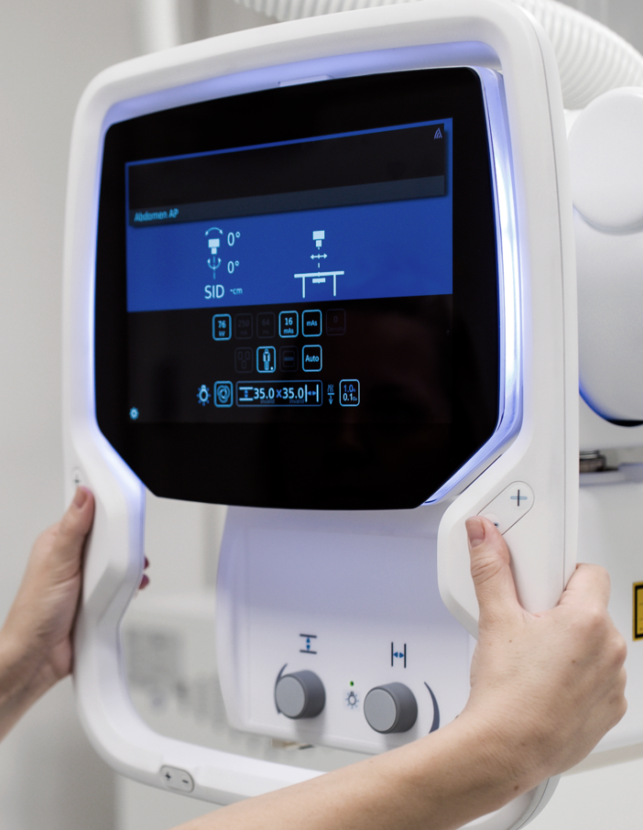
OUR SUPPORT AND EDUCATION
ARCOMA SALES
ARCOMA MARKETING
Sales support, product support, sales training
Marketing materials, Marketing support, Partner portal, image bank
ARCOMA SUPPORT & SERVICE
ARCOMA ACADEMY
Product support, service support, guidance, questions.
Service and installation training, application training, product training, guides.
Notes:
https://www.istockphoto.com/se/foto/osk%C3%A4rpa-bildbakgrund-av-korridor-i-sjukhus-eller-klinik-bild-gm974363768-265081917

Slide 12
THANK YOU
Arcoma AB | Annavägen 1 | 352 46 Växjö | Sweden
PHONE
EMAIL
WEBSITE
+46 470 70 69 00
service@arcoma.se
www.arcoma.se

