Slide 1
PRODUCT PRESENTATION Arcoma Precision

Slide 2
CONTENT
About Arcoma
Arcoma Precision
The detectors
The accessories

Slide 3
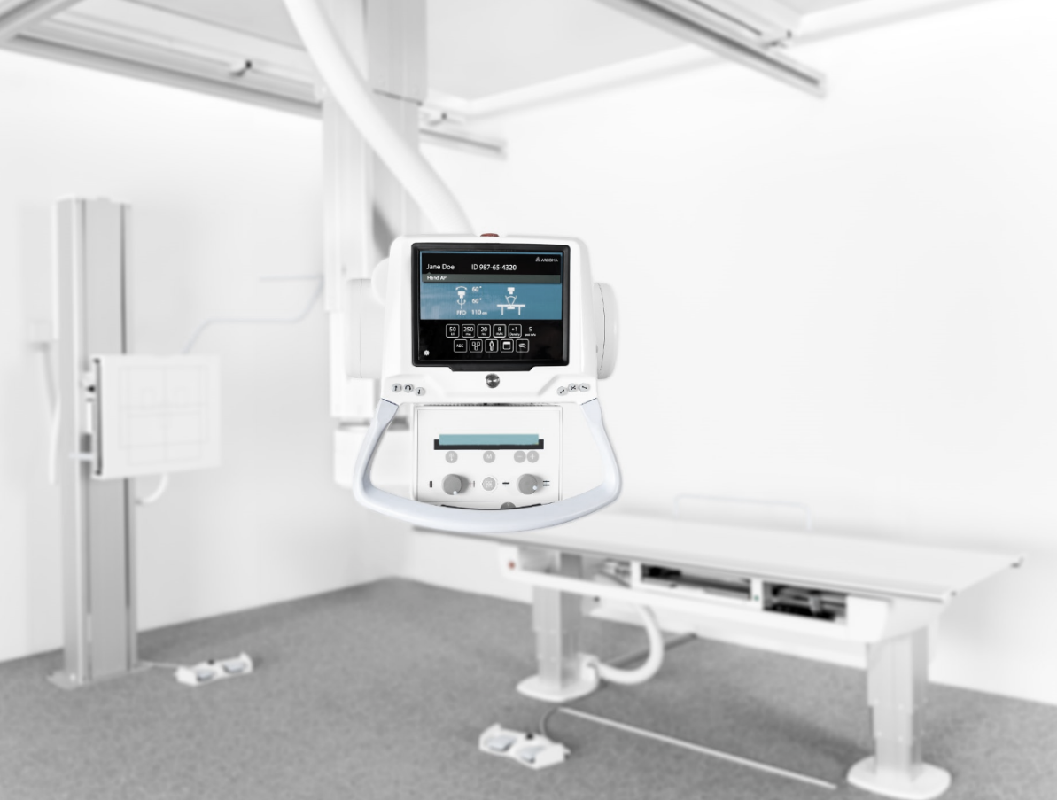
ABOUT ARCOMA
Arcoma develops, produces and provides complete radiology solutions worldwide with the mission to improve care for the patient and the work environment for the user.
Reduce healthcare costs
Improve work environment
Improve patient care

Slide 4
Arcoma offers product solutions covering key clinical applications in the radiology area.
GENERAL CLINIC
MUSCLE/ SKELETON CLINIC
THORACIC CLINIC
PEDIATRIC CLINIC
TRAUMA/
RESUS CLINIC
Notes:
https://www.istockphoto.com/se/foto/patienten-gubbe-h%C3%A5ller-hj%C3%A4rta-f%C3%B6r-hj%C3%A4rtinfarkt-koncept-gm1049772140-280738636
https://www.istockphoto.com/se/foto/sjukgymnaster-anv%C3%A4nder-h%C3%A4nderna-f%C3%B6r-att-greppa-patientens-l%C3%A5r-f%C3%B6r-att-kontrol-lera-gm1147201070-309365276
https://www.istockphoto.com/se/foto/l%C3%A4kare-att-unders%C3%B6ka-patientens-medicinska-journaler-gm902231646-248883193

Slide 5
SUPERIOR WORKFLOW
OUR PRODUCTS ENABLE
UNIQUE
RELIABILITY
EXCELLENT DIAGNOSTIC RESULTS
Notes:
Brilliant
Impressive
Terrific
Fantastic
Significant
Unique

Slide 6
ARCOMA PRECISION

Slide 7
OUR PRODUCT LINES
ARCOMA PRECISION
PREMIUM DIGITAL X-RAY SYSTEM
Arcoma Precision is a premium digital x-ray system that provides high image quality, clinical flexibility and superior workflow for a wide range of radiographic applications. Its ergonomic design and sophisticated auto positioning technology help you maximize patient throughput.
Notes:
To change the image behind the Mock up.
Select the layer - > Right Click -> Send to Back -> Delete the image -> Drag & Drop your Own Picture -> Send to Back (again)

Slide 8
Low dose
Excellent imaging result
Safe investment
Flexible detector configurations
Superior workflow
Superior ergonomics
ARCOMA PRECISION
PREMIUM DIGITAL X-RAY SYSTEM
Notes:
To change the image behind the Mock up.
Select the layer - > Right Click -> Send to Back -> Delete the image -> Drag & Drop your Own Picture -> Send to Back (again)

Slide 9
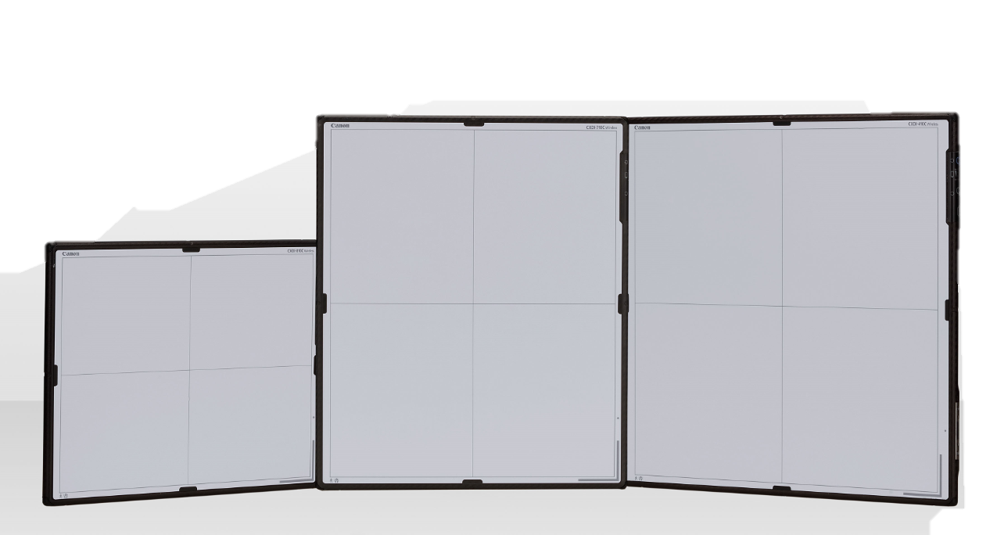
SUPERIOR WORKFLOW
AUTO POSITIONING
Fully motorized auto-positioning when anatomical protocol selected.
EASY-TO-USE INTERFACE
Easy-to-use interface with preview image shown in approximately / ~ 1 second *1).
EXCELLENT FINE-TUNING
Fine tuning into the right position is done manually, with minimal force needed.
MOTORIZED WALL STAND
Upward and downward easy positioning from the control panel or using the foot control (optional).
AUTOMATIC DETECTOR TRACKING
WIRELESS DETECTORS
Ultralight, flexible and wireless detectors.
The tube automatically tracks the position of the detector so that the user can focus on the patient.
*1) Depending on acquisition mode
Notes:
Easy to use interface
Quick start-up
Auto positioning
Excellent fine tuning
Easy access for patients
Easy stitching

Slide 10
SAFE INVESTMENT
Arcoma Precision is designed for the productivity and versatility needs of high-volume hospital imaging departments.
Its robust construction and high quality helps ensure reliable operation, minimal service and a long product lifespan, all of which lowers the lifetime cost.
Reliable operation
Minimal service needs
Long product lifespan
Low lifetime cost
Notes:
Very reliable operation
Support and service
Long life time
Low life time cost

Slide 11
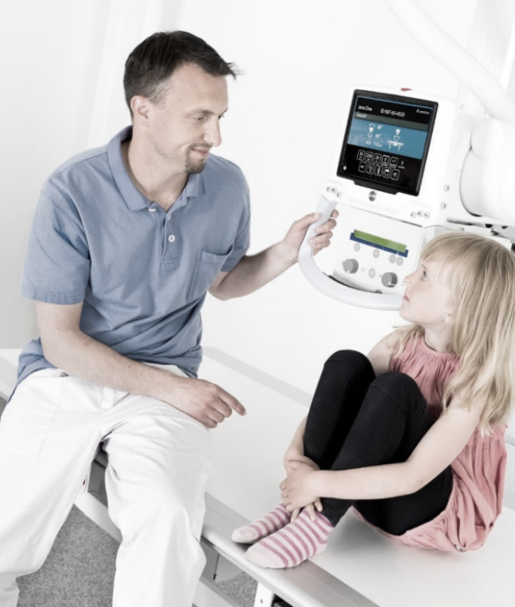
LOW DOSE
Arcoma Precision provides high quality imaging with low dose for maximum patient safety. Software simulated grid is available as an option. It can be used for patients of all sizes and lower the dose by up to 60%.
Components that contribute to dose reduction
Arcoma continuously works to create a lower radiation dose in our solutions. Examples of components in the Arcoma Precision system that contribute to dose reduction:
CANON DETECTORS WITH HIGH DQE
SOFTWARE SIMULATED GRID*
AUTOMATIC EXPOSURE CONTROL
* Scatter correction software (option)
Notes:
Other things that reduces the dose level:
Advanced Image Processing algorithms.
Scatter Correction Software (all anatomies).
Automatic Exposure Control: Consistency + correct dose level.
Grid can be used to reduce noise introduced by scattered radiation. Grid can also easily be removed.
X-ray tube filtration: Can be automatically selected.
Dose Area Product (DAP) monitoring.
Accurate positioning alignment.

Slide 12
Components that contribute to low dose
Arcoma continuously works to create a lower radiation dose in our solutions. The following components in the Arcoma Precision system contribute to dose reduction:
CANON DETECTORS WITH HIGH DQE
The Canon detectors have high DQE (detective quantum efficiency), which provides a more efficient use of radiation, (i.e. low dosage) and high quality images.
SOFTWARE SIMULATED GRID
Dose can be reduced by up to 60% using a virtual grid (optional scatter correction software) for bedside examinations, rather then a physical grid.
DOSE MONITORING
The system is equipped with a Dose Area Meter (optional) that will measure and transfer the patient dose.
AUTOMATIC EXPOSURE CONTROL
Automatic exposure control automatically sets the exposure parameters for a specific patient and ensures good image quality with minimal dose.
PREDEFINED PROTOCOLS
Predefined protocols for different patient sizes can easily be selected from the tube display to adapt the adapt the dose accordingly.
Notes:
Other things that reduces the dose level:
Advanced Image Processing algorithms.
Scatter Correction Software (all anatomies).
Automatic Exposure Control: Consistency + correct dose level.
Grid can be used to reduce noise introduced by scattered radiation. Grid can also easily be removed.
X-ray tube filtration: Can be automatically selected.
Dose Area Product (DAP) monitoring.
Accurate positioning alignment.

Slide 13
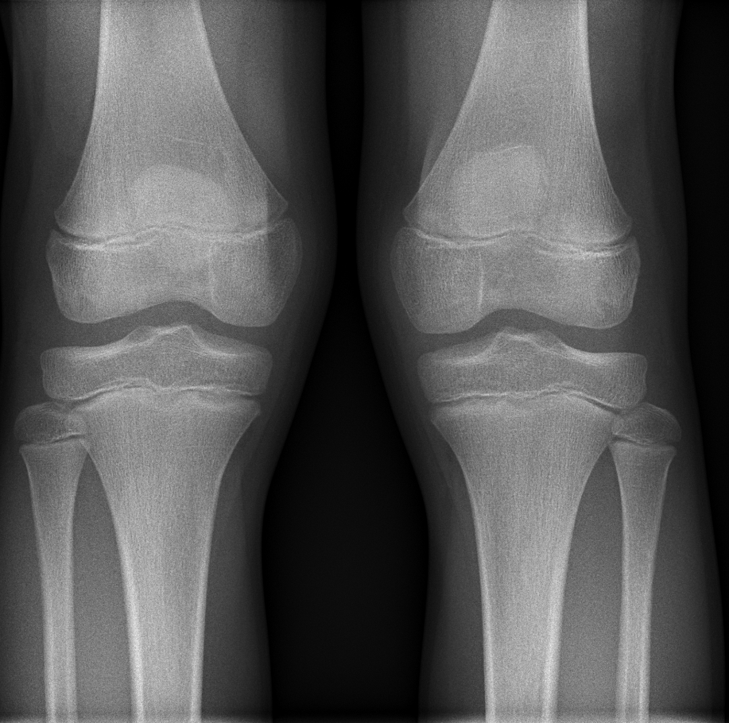
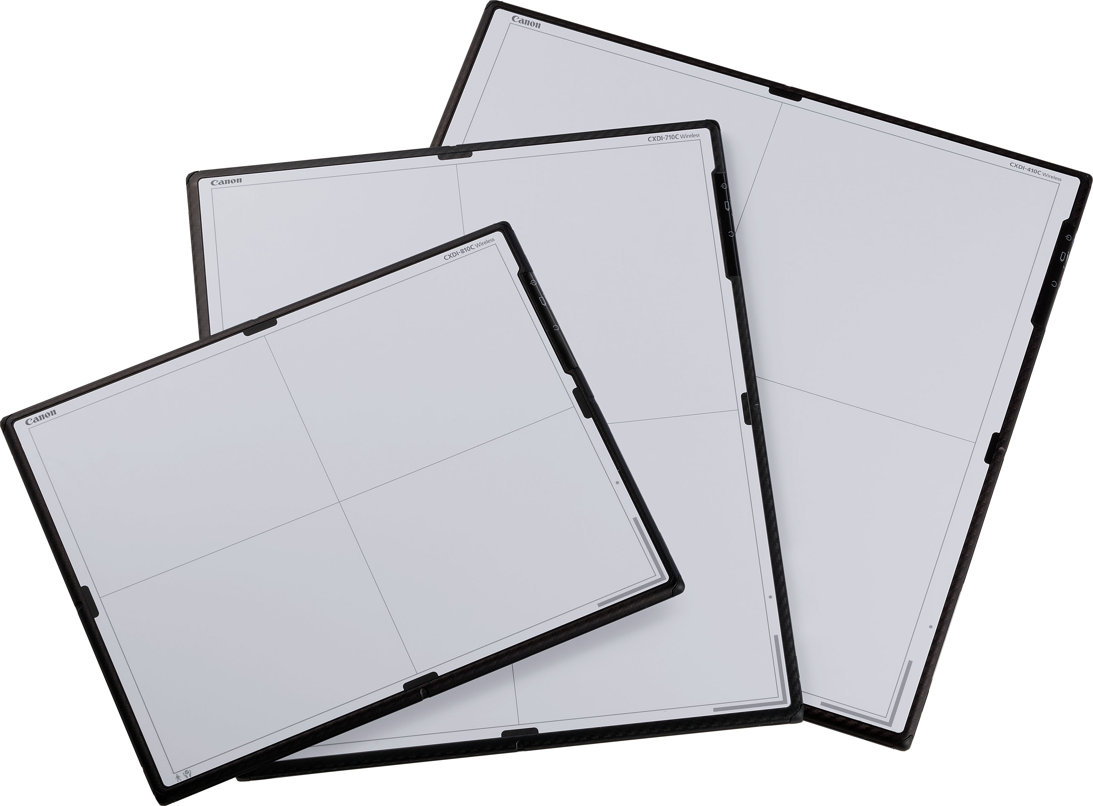
EXCELLENT IMAGING RESULT
Precision is powered by Canon’s next generation wireless CXDI detectors and imaging software.
Canon´s CXDI-NE software provides a GUI* that is always right for you. Comprehensive image processing, including software simulated grid, guarantees optimal image quality and minimal dose.
* GUI = graphical user interface
Notes:
Fast and efficient positioning is one of the most important things for a radiologist.
Arcoma Precision enables easy and quick positioning thanks to auto positioning, automatic detector tracking and motorized wall stand.

Slide 14
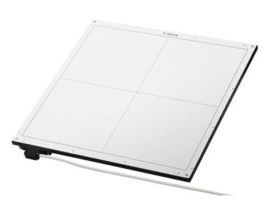
FLEXIBLE DETECTOR CONFIGURATIONS
The ultra lightweight, waterproof detectors (IP 57) with integrated battery and image storage can be used on board or stand-alone.
Up to 4 detectors can be used with Precision to provide optimal positioning and imaging flexibility. The detectors can also be:
shared between x-ray rooms
used for mobile X-ray solutions
used in the holder or wireless

Slide 15
SUPERIOR ERGONOMICS
Patient centric care is Arcoma´s approach to everything we design. Our focus is to provide an environment that minimizes stress on staff and maximizes comfort for the patient.
Arcoma Precision´s motorized and automatic movements, together with the lightweight OTC and flexible table design, make it an ideal ergonomic solution for both patient and operator.
Motorized movements, smooth and silent
Lightweight OTC, easy fine-tuning
Motorized table, ergonomic working height
Notes:
What samsung says:
State-of-the-art ergonomics
• Designed to minimize stress on staff and maximize patient comfort
• One-touch, stress-free DR with minimum manual handling
• Automatic, smooth, low-noise motorized movements
• SmartHandle with inTouch technology for intuitive manual control & adjustments
• 12” floating touch screen user interface remains horizontal to the user regardless of tube rotation
• Configurable inLight in equipment ceiling dims when the colli-mator light is activated

Slide 16
THE DETECTORS - A DEEPER LOOK

Slide 17
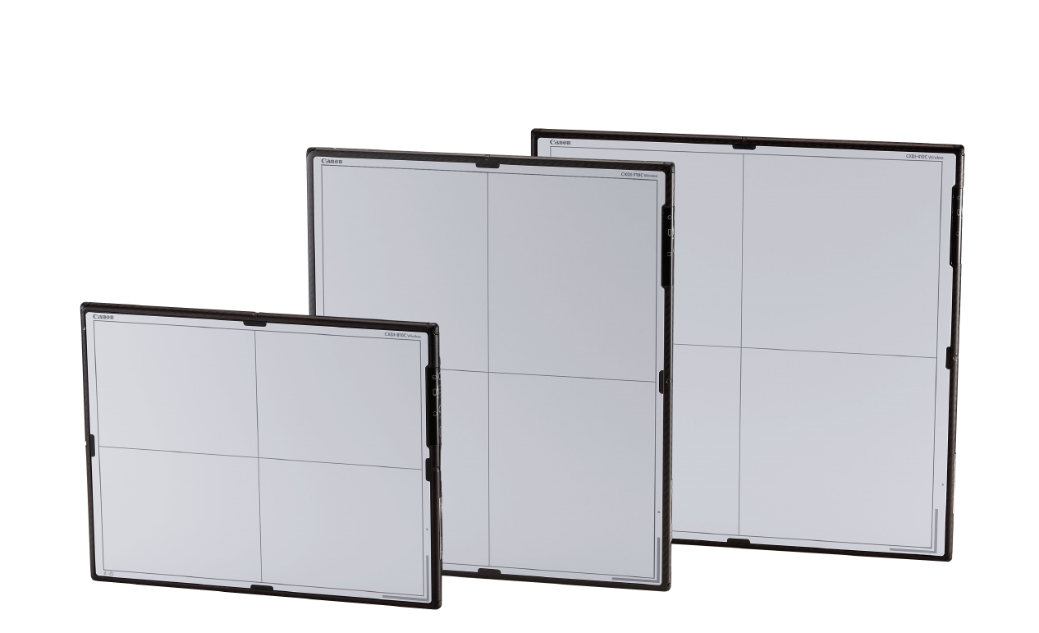
CANON DETECTORS
Arcoma Precision is powered by detectors from Canon.
With more than 100 years of experience within medical imaging Canon delivers the most advanced detector solutions on the market.

Slide 18
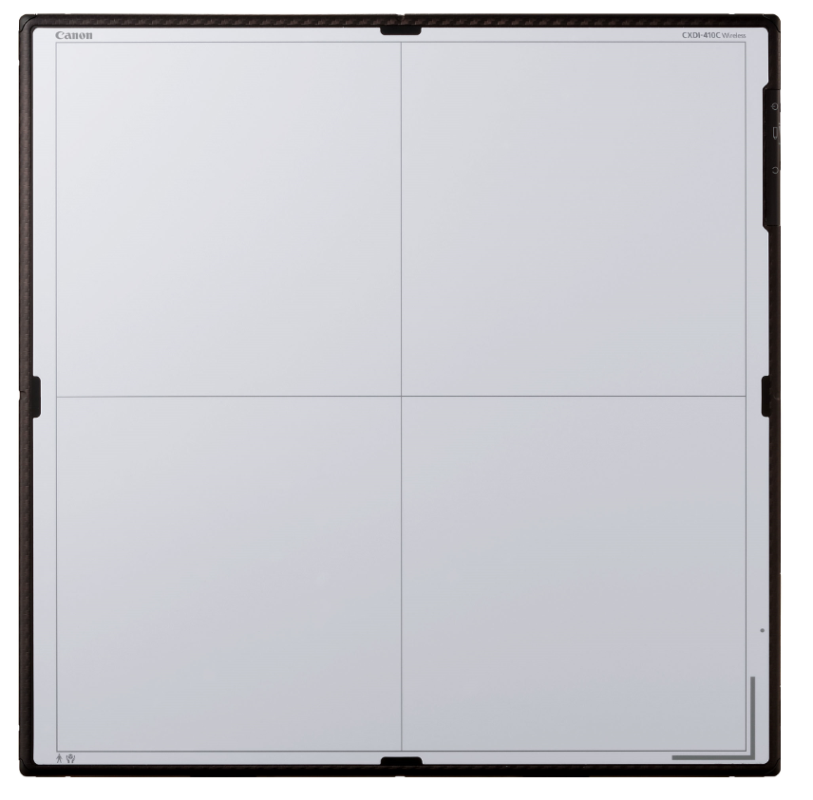
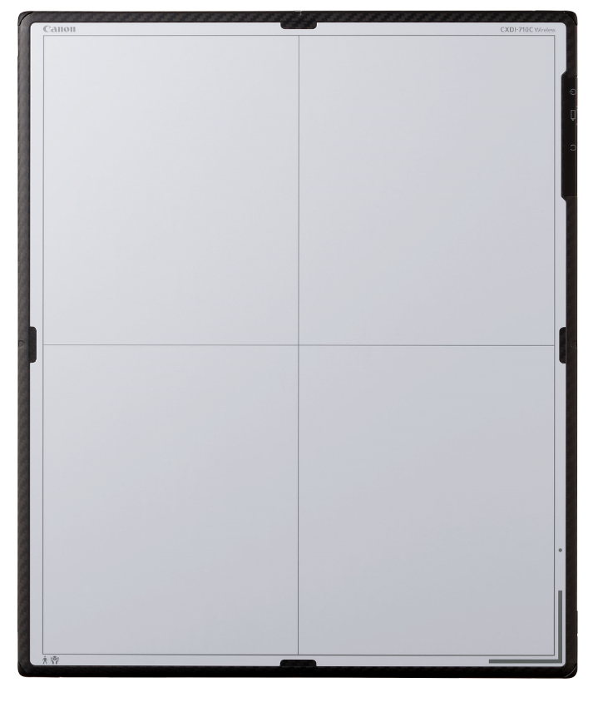
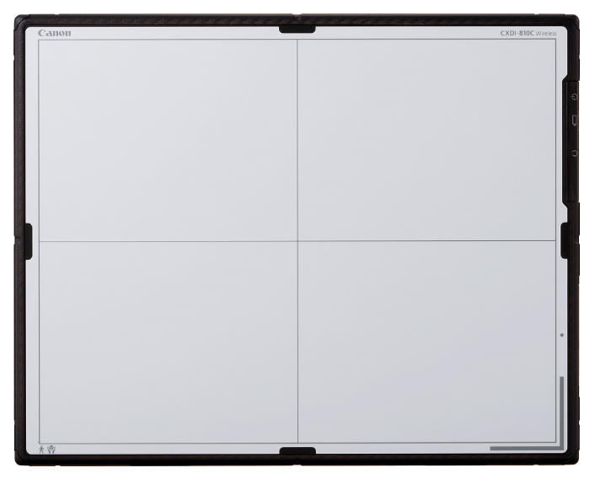
THE DETECTORS
CXDI-410C W
CXDI-710C W
CXDI-810C W
CXDI-401C Compact
Wireless
2,8 kg
Size: 42,6 x 41,5 cm
Effective image area: 426x 415mm
Image matrix size: 3320 x 3408 mm
Wireless
2,3 kg
Size: 35.0x42.6 cm
Effective image area: 350 x 426 mm
Image matrix size: 2800 x 3408pixels
Wireless
1,8 kg
Size: 35.0x27.4 cm
Effective image area: 350 x 274 mm
Image matrix size: 2800 x 2192 mm
Fixed
Size: Approx. 46.0 (W) x 49.0 (H) x 15 (D) cm
Effective image area: 415x426 mm
Image matrix size: 3320x 3408 pixels

Slide 19
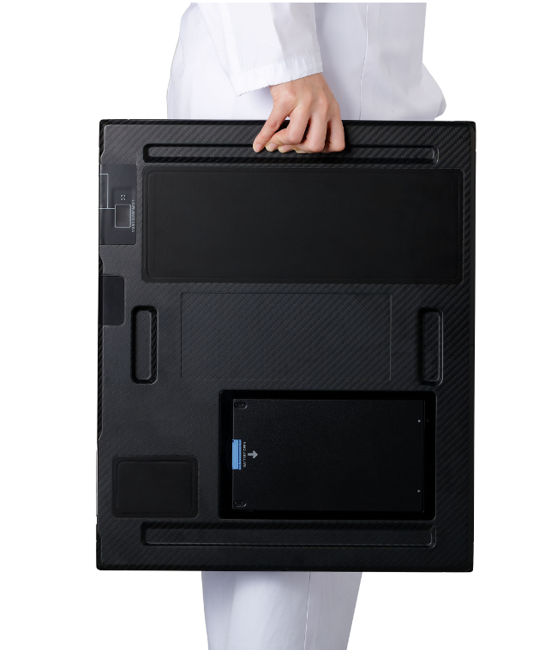
DETECTOR BENEFITS
NONSTOP USE WITH DURABLE DESIGN
Strong and durable design as well as IPX7 waterproof ensures nonstop use.
LIGHTWEIGHT AND ERGONOMIC
Ultralight easy to use detectors supports increased workflow and ergonomic for the user.
PERFECT IMAGE QUALITY
High resolution, high sensitivity and high signal to noise performance ensures perfect image quality without increasing dose.

Slide 20
DETECTOR - FEATURES
FEATURES
Load capacity of 310 kg
Waterproof - IPX7 compliant
On-board image storage – up to 99 images
Multi-function docking station
Super-lightweight design – the lightest 1,8 kg
Handgrips for easy transfer
Colour coding
Preview image time: 1 seconds
Cycle time: 7 seconds

Slide 21
DETECTOR INTEGRATION WITH FULL FLEXIBILITY
Detector | Wall stand | Table | Free | Details:
CXDI-410C | yes | yes | Yes | Wireless 42,6 x 1,5 cm 2,8 kg
 | Status indicator Charging in holder | Status indicator Charging in holder
CXDI-710C | yes | yes | Yes | Wireless 35,0 x 42,6 cm 2,3 kg
 | Status indicator Charging in holder | Status indicator Charging in holder
CXDI-810C | Not applicable | Not applicable | yes | Wireless 35,0 x 27,4 cm 1,8 kg
CXDI-401C Compact | yes | yes | Not applicable | Fix 46 x 49 cm
Other options: | Left/Right hand loading of grid & Wireless detector | Not applicable | Not applicable
The wall stand and the table can hold either the CXI-710C W, CXDI-401C W or the CXDI-401C Compact.
Wireless image transfer for the CXDI-710C W and CXDI-410C W.
Automatic charging of battery when the detectors are placed in the detector holders.
Free: CXDI-810C W
CXDI-710C W
CXDI-410C W
CXDI-410C Compact

Slide 22
ACCESSORIES

Slide 23
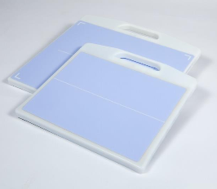
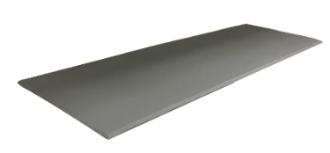
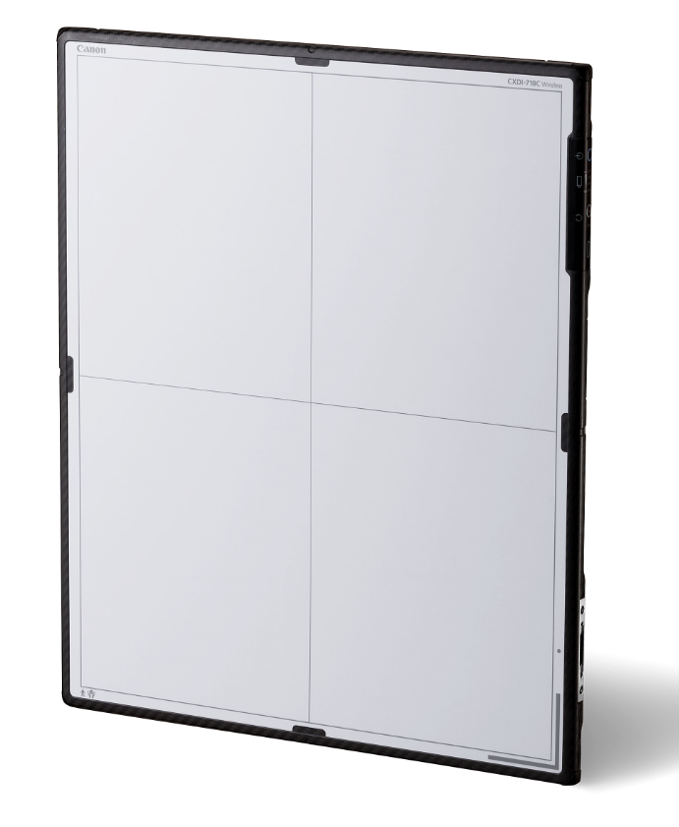
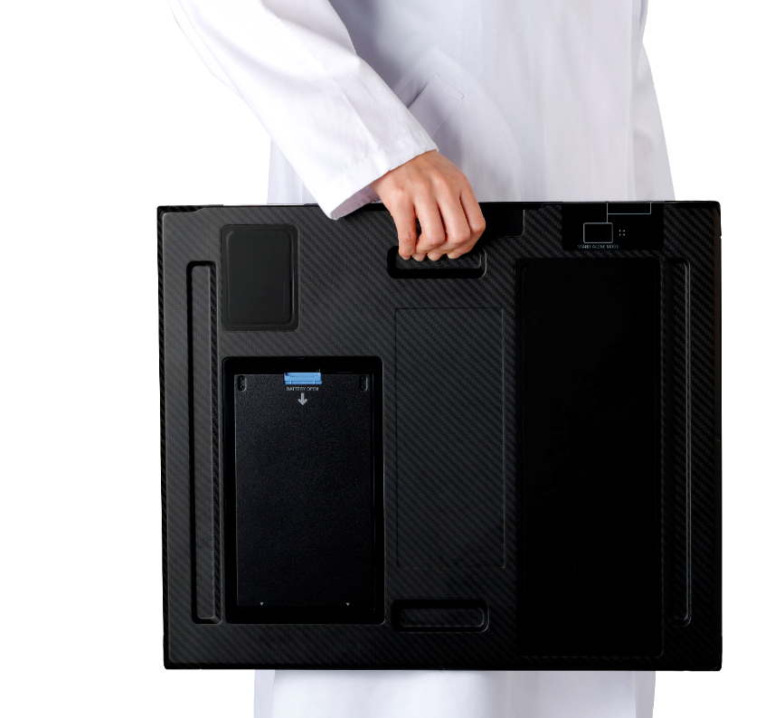
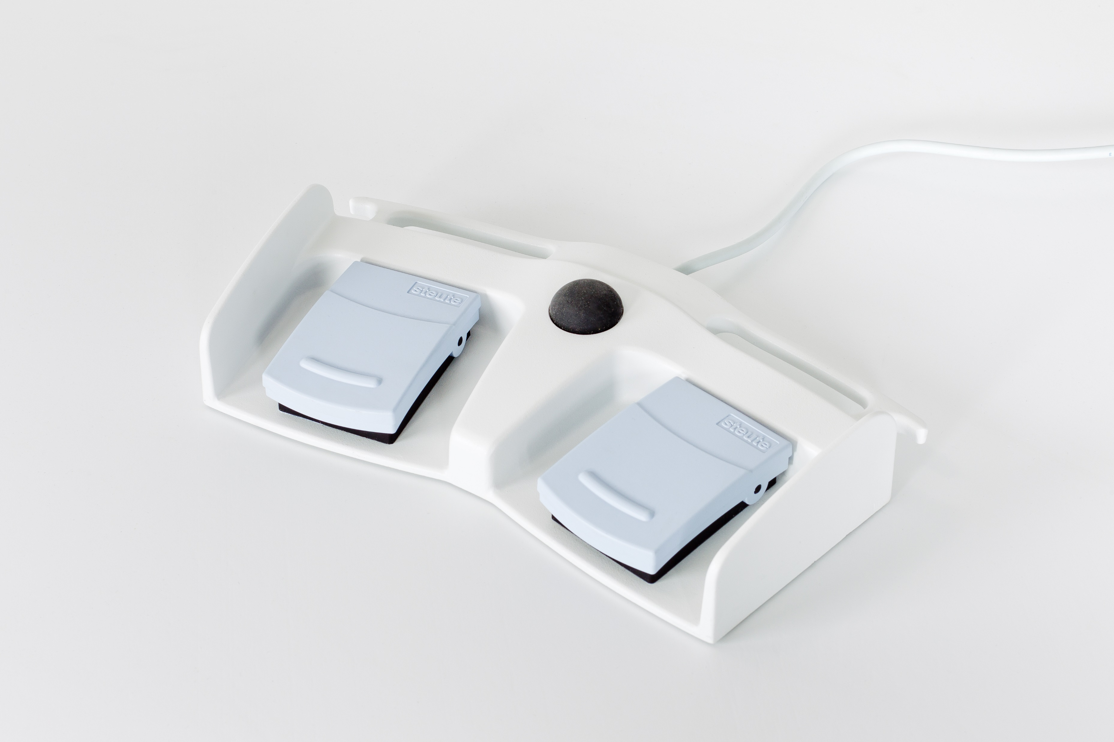
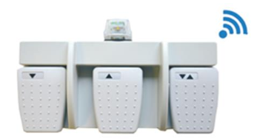
ACCESSORIES
We offer a wide range of accessories to fit the needs of our customers.

